Slide 1
Engineering
Communications
Spring 2017
Speaking & Writing Tips
. .
Boz Bowles
Coordinator, Engineering Communication Studio
Chevron Center for Engineering Education
1233 Patrick F. Taylor Hall, LSU
578-9952
dbowles@lsu.edu
cxc.lsu.edu/ecs
Notes:
We are trying to get this presentation in a nice formal format but we aren’t there yet. If you can’t get Boz to come give the presentation to your school and would like to give this presentation in your classroom, follow this link to learn what to say for each slide. https://youtu.be/8klMl83BGEA

Slide 2
Learning Objectives
Use technology to communicate effectively in various settings and contexts.
Understand how to use an effective writing process.
Understand how to develop technical engineering presentations.
Understand how to make effective technical posters.

Slide 3
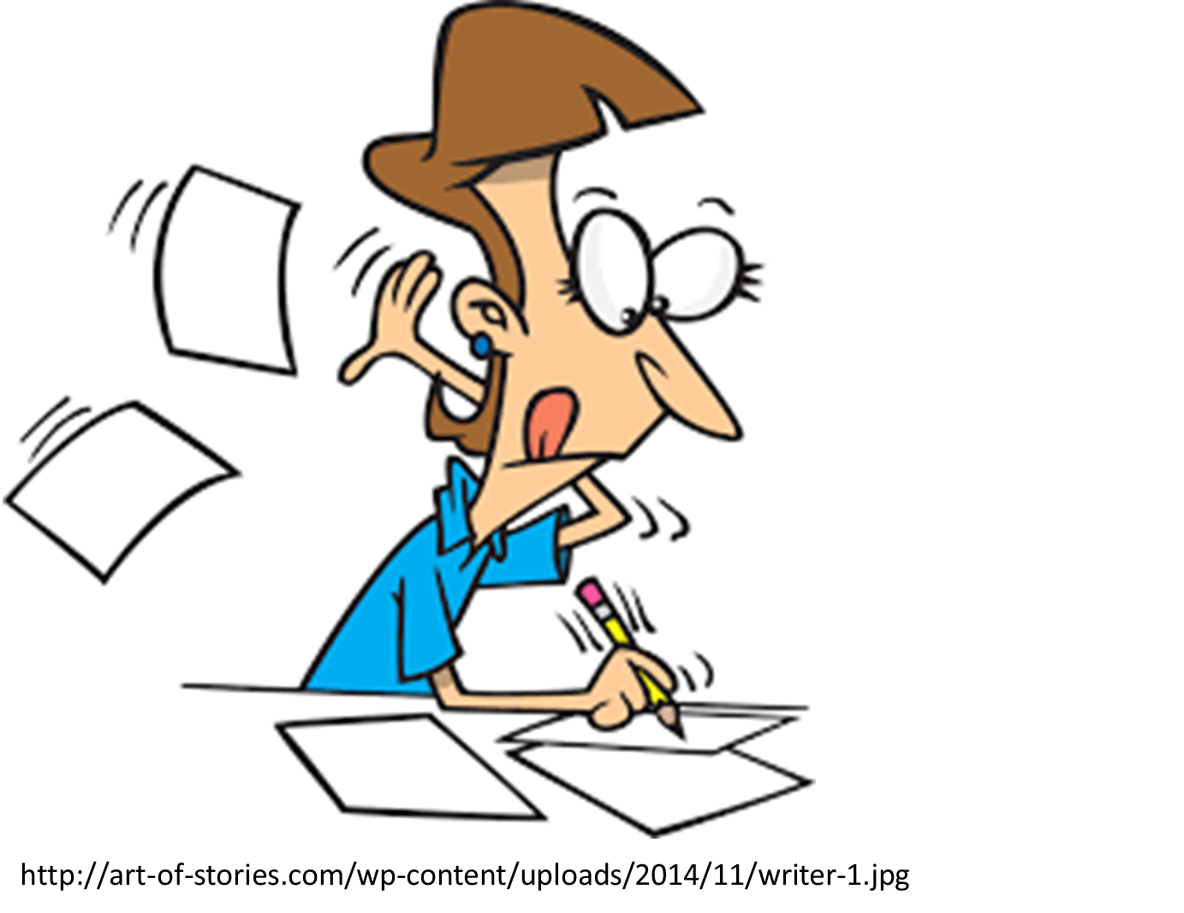
Today’s Topics: Developing an Effective Writing Process

Slide 4
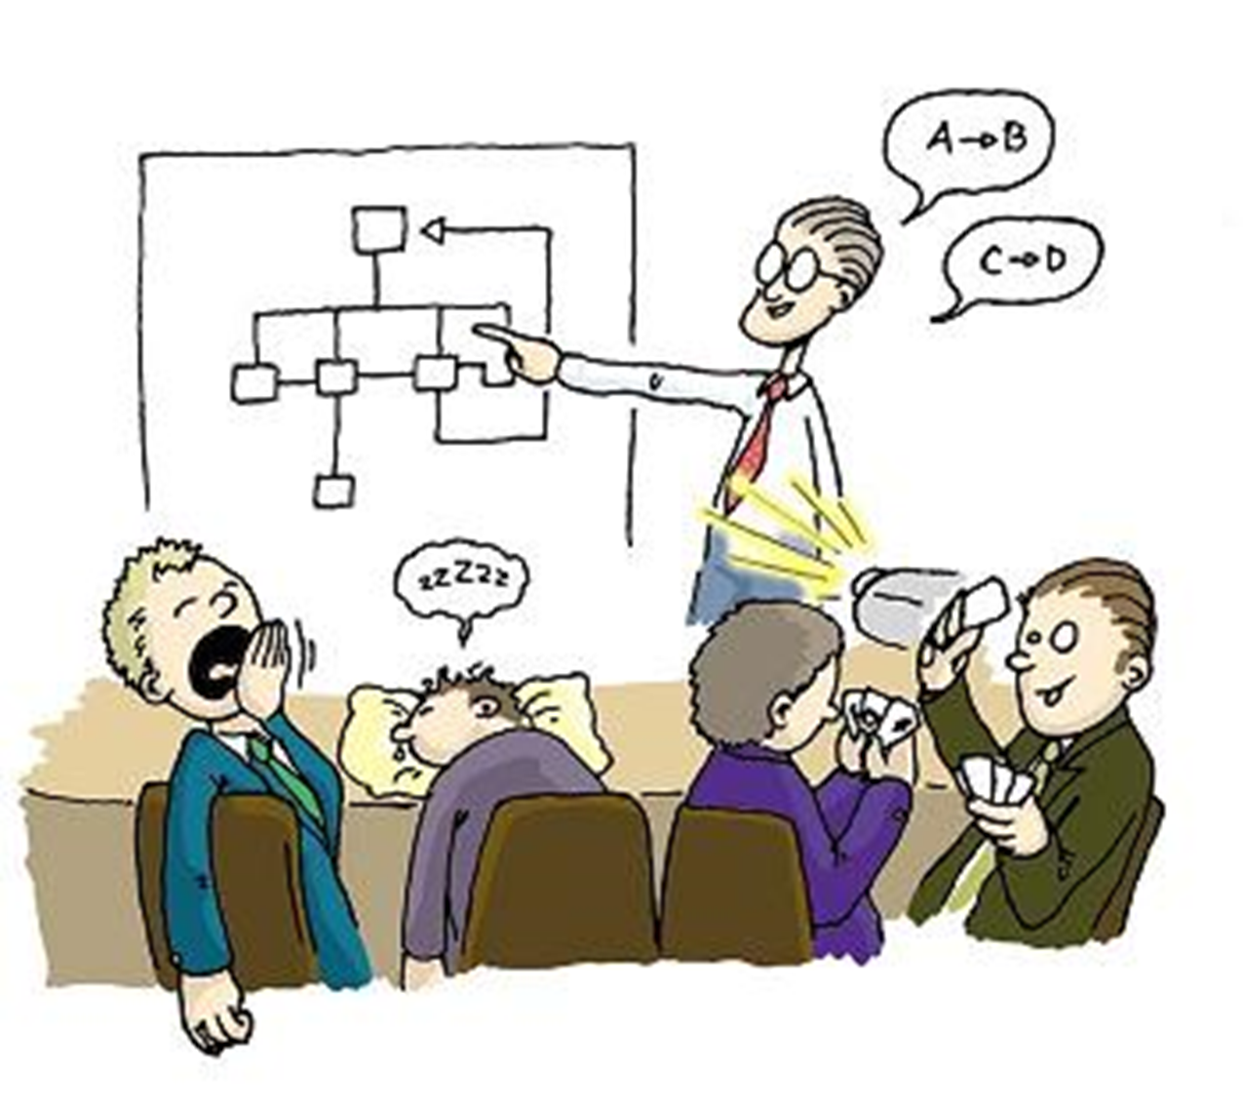
Today’s Topics: Engineering Technical Presentations
http://www.personal-development-is-fun.com/images/public-speaking-activities.jpg

Slide 5
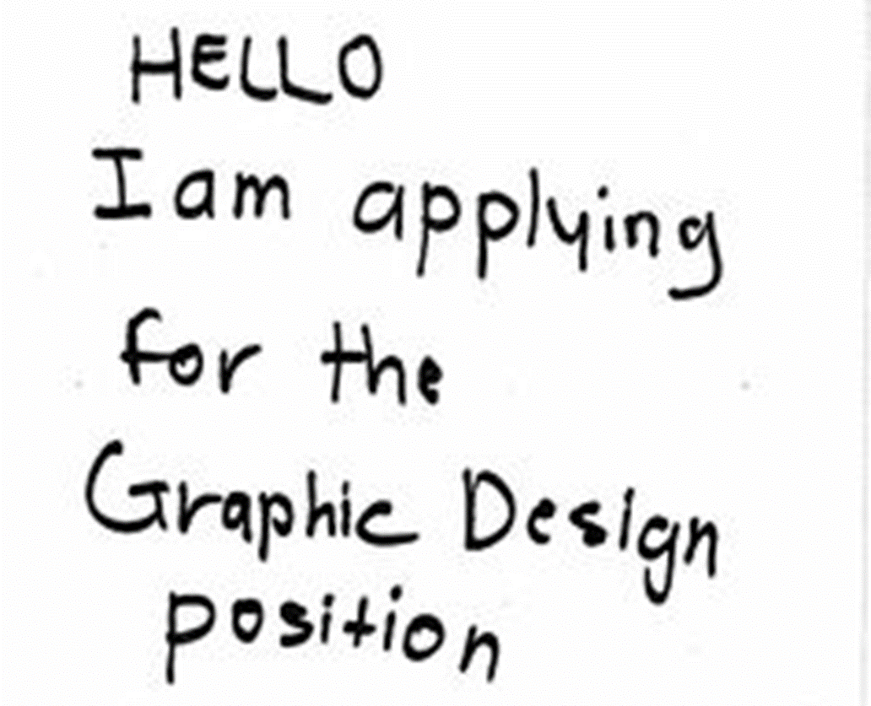
Today’s Topics: Making Technical Posters
https://s-media-cache-ak0.pinimg.com/236x/41/ee/61/41ee6191be274b5fce1beff0c01a27c8.jpg

Slide 6
The Rhetorical Triangle illustrates the 3 questions you should always ask in rhetorical situations.
Credibility
Audience
Purpose

Slide 7
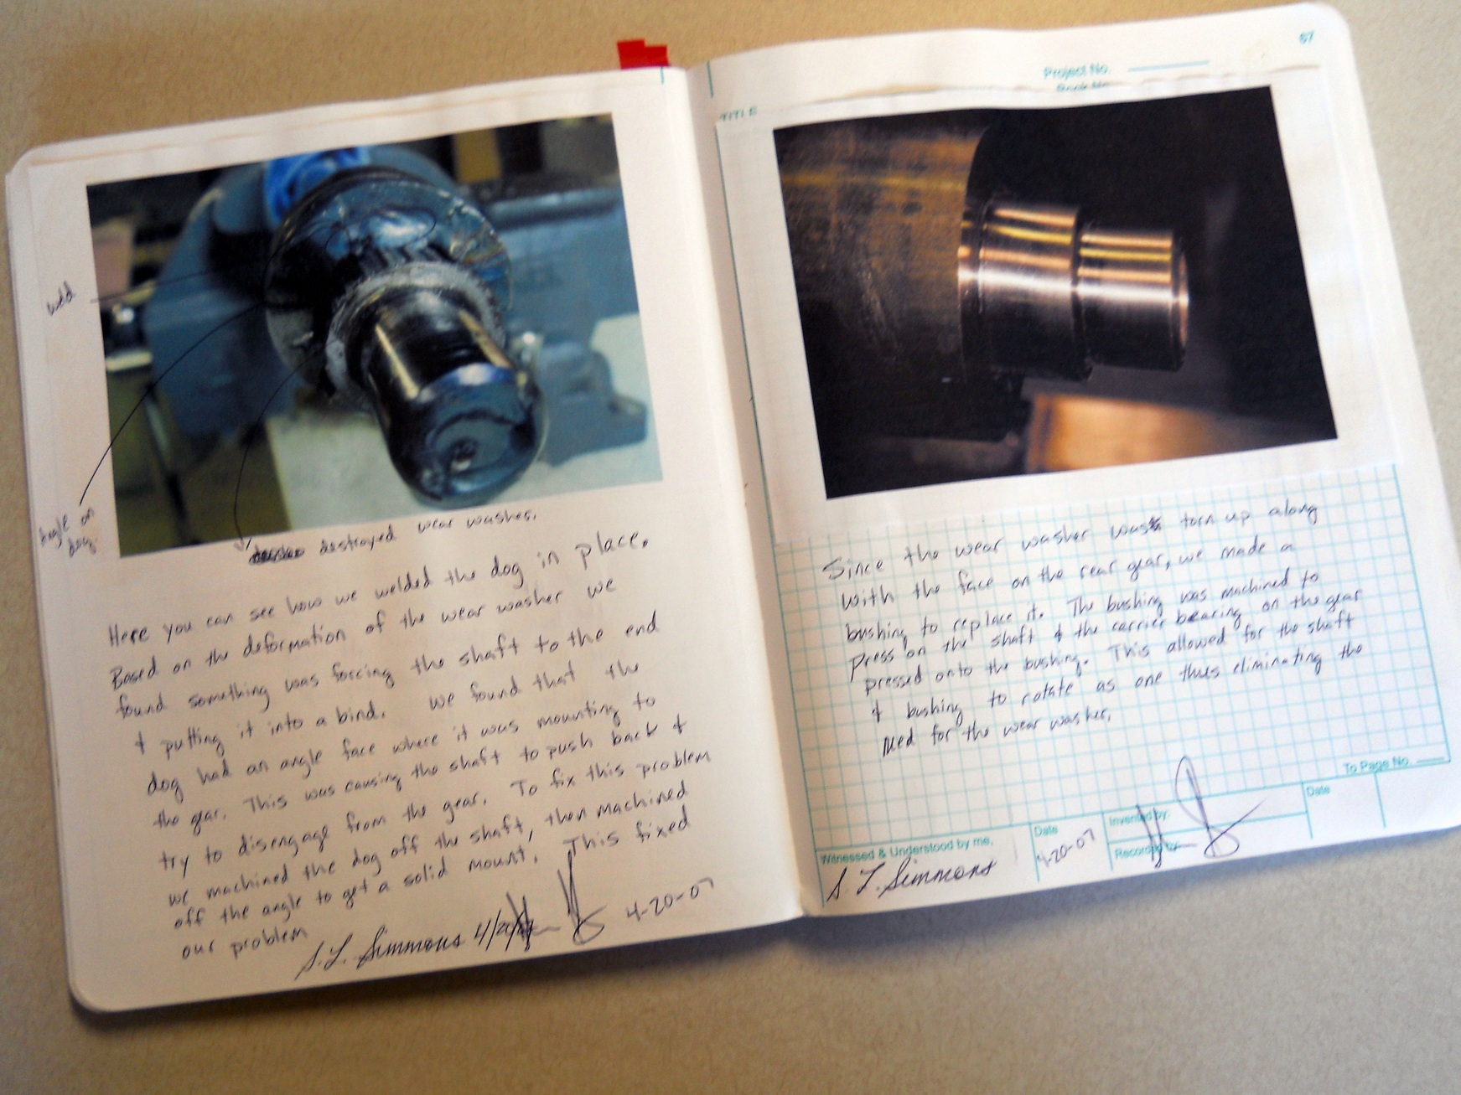
Communicating should not come AFTER the engineering; it’s PART OF the engineering.

Slide 8
Develop a complete composing process.
Prewriting
Brainstorming
Design Notebook
Drafting
Outlining
Early Drafting
Polishing
Revising
Editing

Slide 9
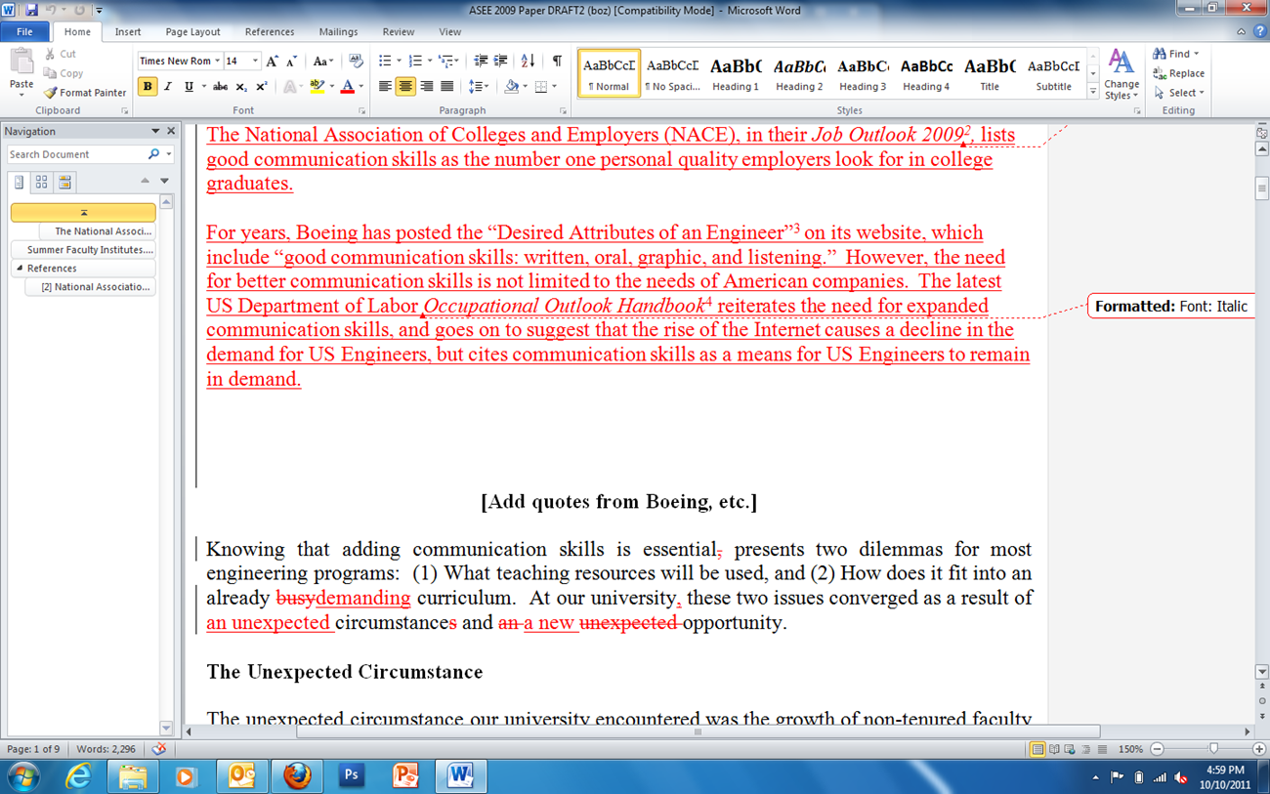
Revise, revise, revise…then edit, edit, edit!
Give yourself permission to write lousy first drafts.
Lots of short sessions work better than one long one.

Slide 10
Rather than presenting info in the order you discovered it…
Automated Retrieval System
Onboard CPU
Independently actuated appendages
Clamp mounted on a 3-axis joint
Voice activated
Water and air cooled
Runs on biofuel

Slide 11

Give them context first!

Slide 12
Give information in amounts your audience can absorb.
If you write too much information on a slide, then your audience will stop listening to you. They will also probably not be able to read the entire slide in the time allotted, or they will simply lose interest. In fact, the only thing using chunks of text is good for is hiding information. If you’ve read this far, raise your hand. We’ll see how many do it. A good rule of thumb is to use no more than three or four lines of text per slide. Anything beyond that is difficult to read. It confounds your purpose and bores your audience. I mean, did you make it this far?

Slide 13
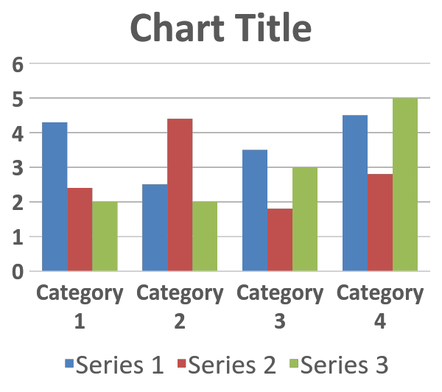
Results
The heading does very little for the audience.
Here, you would tell us what the chart implies
You would usually follow up with other points
Sometimes those points would be divided further
So we’d get this point
Then we’d get another

Slide 14
Results
Even the improved version of a chart can be difficult to understand quickly.
Here, you would tell us what the chart implies
You would usually follow up with other points
Sometimes those points would be divided further
So we’d get this point
Then we’d get another

Slide 15
Results
This is like showing the audience your teleprompter
Here, you would tell us what the chart implies
You would usually follow up with other points
Sometimes those points would be divided further
So we’d get this point
Then we’d get another
Bullets are tedious for the audience!

Slide 16
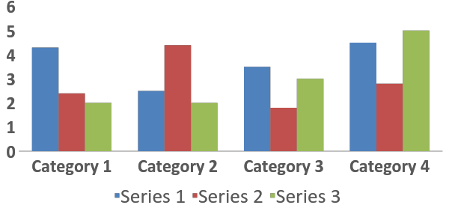
Put your main assertion in the upper left corner—no more than 2 lines of text.
Use color to tie the text to elements on the chart
Use blank spaces to sequence in the points that ordinarily would have been bullet points

Slide 17
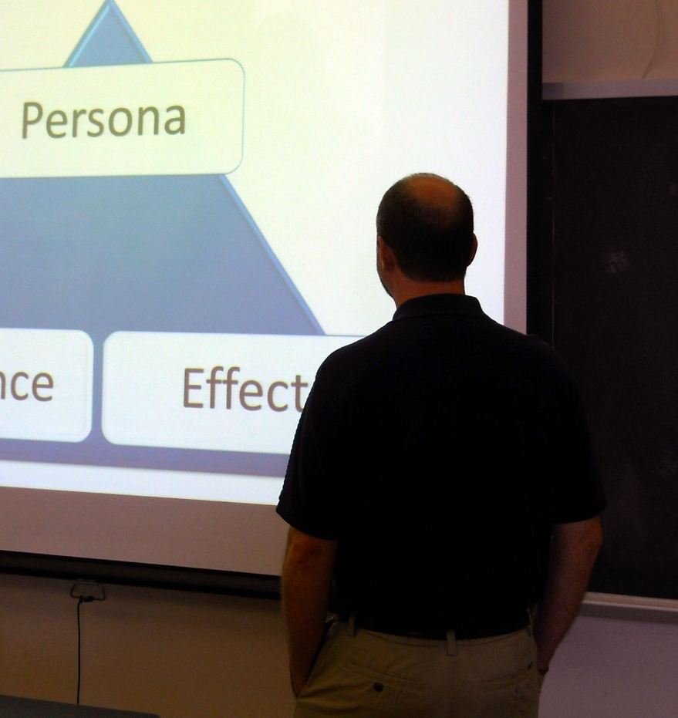
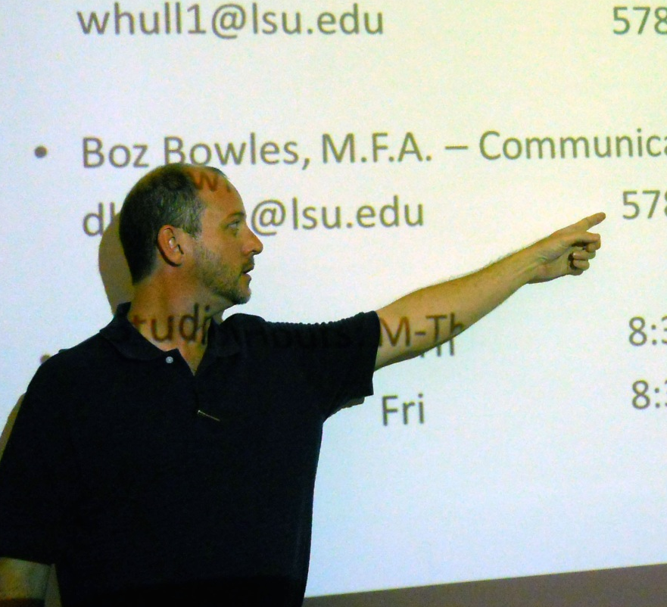
You are visual communication!
Stand straight, and face your audience.
Stay out of your own projection field.

Slide 18

Your eyes are magical!
Art-dept.com, keyword: eyes

Slide 19
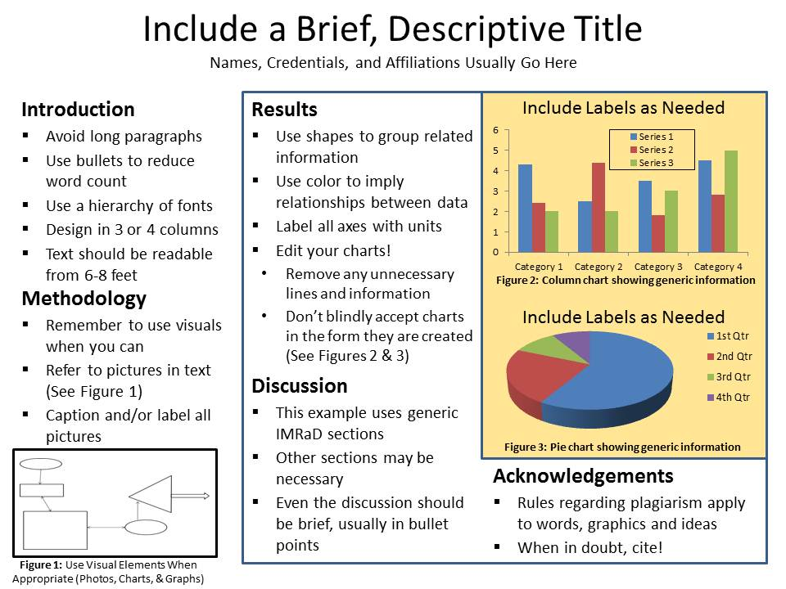
Notes:
IMRDA

Slide 20
Auto-Pilot

Slide 21


Images from the web rarely work on a poster.
Web image standard is 72 dpi (or pixels/inch)
Printing standard is 300 dpi (200 dpi might work)
A 2-inch wide web image stretched to 10-inch width yields a pixel-riddled mess!
Appendix

Slide 22
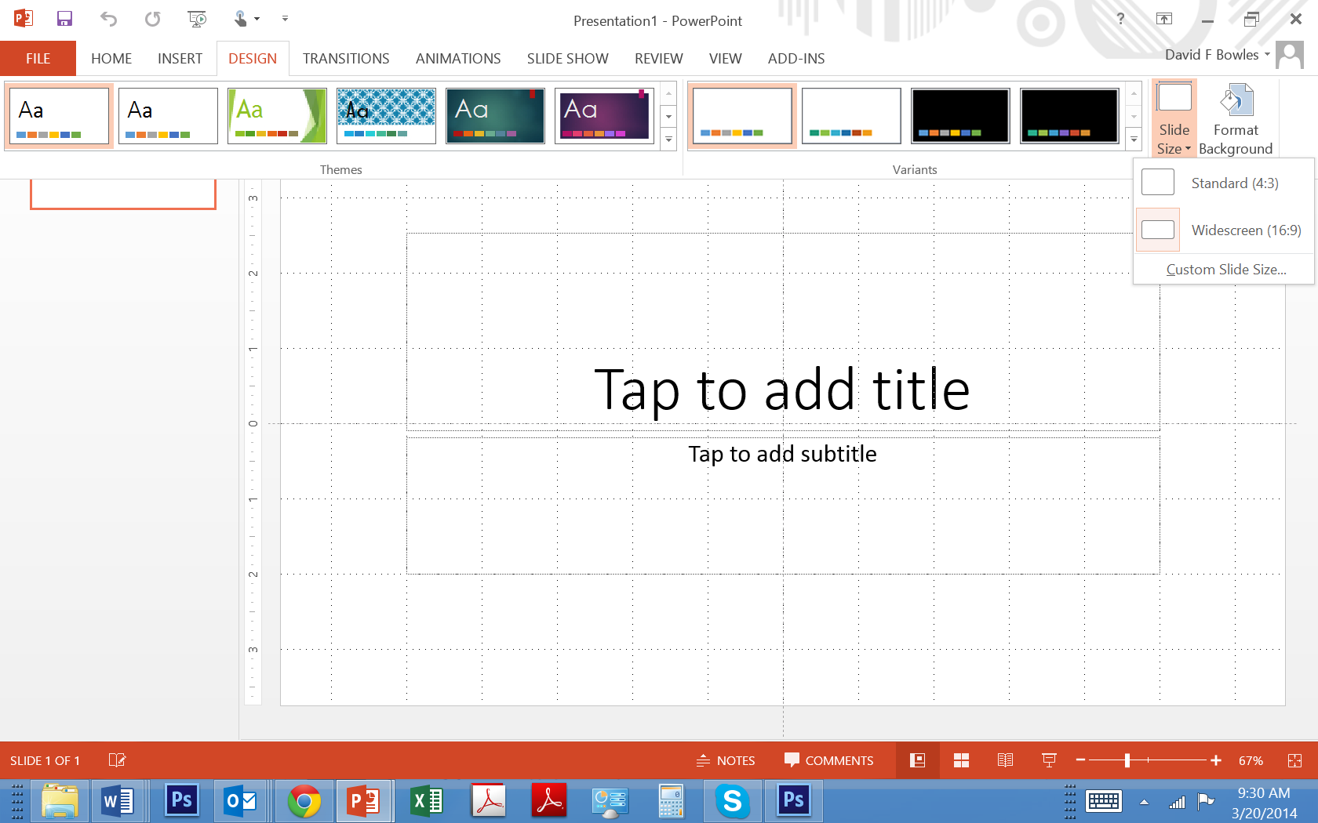
The easiest program to use is PowerPoint.
First, you’ll need to set the dimensions of your poster. Don’t do this after you compose; it’ll cause problems!

